Slide 1
Subway Service Corporation System
TEAM
Sanjana Disawal (RA2211056010113)
Sohamsingh Thakur(RA2211056010118)
Sneha Gupta (RA2211056010134)

Slide 2
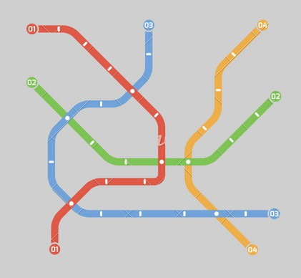
ABSTRACT
This project presents a Subway Service Corporation System (SSCS), developed using SQL, focusing on efficient passenger ticketing, reservation, and metro operation management.
The system focuses online and offline booking, cancellation, and seat selection. It utilizes relational databases to store train schedules, fare details, passenger information, and reservation data, ensuring consistency and accessibility.
The system leverages the power of SQL queries for data retrieval, manipulation, and reporting, enabling comprehensive analysis of passenger trends, revenue generation, and resource utilization.
Employing MySQL as the database platform ensures scalability, cost-effectiveness, and ease of deployment.

Slide 3
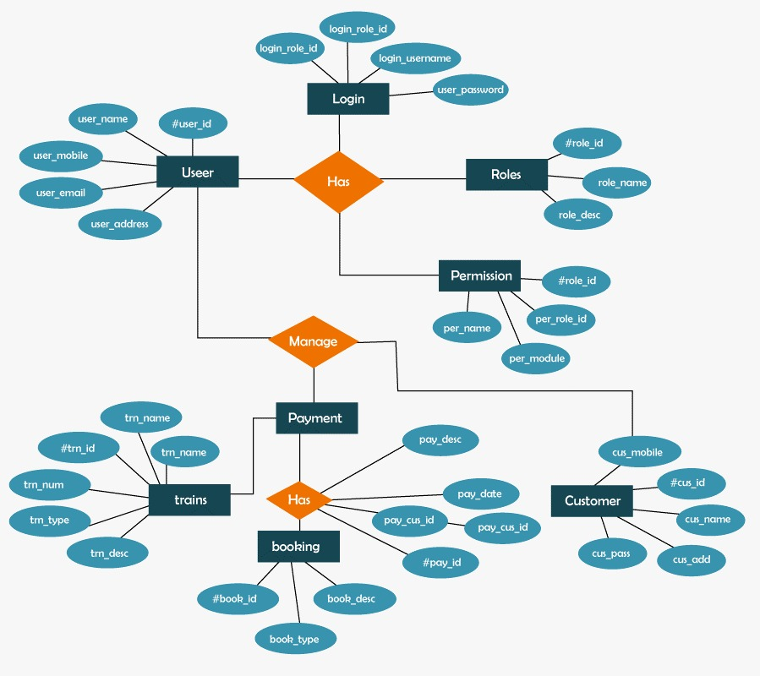
ER DIAGRAM

Slide 4
PROBLEM STATEMENT
Efficient management of metro operations, including passenger ticketing, reservation, and metro operations, remains a critical challenge in the transportation sector.
Existing systems often lack the necessary
features for tracking, and
and
streamlined booking processes, real-time
comprehensive data analysis, leading to inefficiencies suboptimal passenger experiences.
There is a need for a robust Subway Service Corporation System (SSCS) that leverages modern technologies such as SQL databases to address these shortcomings and provide a user- friendly, scalable solution for metro operators.
This project aims to develop and implement such an SSCS, focusing on enhancing the efficiency of passenger services, optimizing resource utilization, and enabling data-driven decision-making in metro operations.

Slide 5
PROJECT DETAILS
Key features of the Project are -
Passenger Ticketing: The system will provide an online and offline ticketing system for passengers, allowing them to book tickets easily.
Reservation Management: Passengers will be able to reserve seats in advance, and the system will manage reservations efficiently.
Metro Operations Management: The SSCS will handle various aspects of metro operations, including scheduling, route planning, and maintenance scheduling.
Comprehensive Data Analysis: The system will analyze passenger data, revenue generation, and resource utilization to provide insights for decision-making.
Scalability and Flexibility: Leveraging SQL databases, the SSCS will be scalable to accommodate growing demands and flexible to adapt to changing requirements.
User-Friendly Interface: The system will feature a user-friendly interface for both passengers and metro operators, ensuring ease of use and accessibility.

Slide 6

SCOPE OF PROJECT
System Requirements Specification (SRS) Document: Detailing the functional and non-functional requirements of the SSCS.
System Design Document: Outlining the architecture, database schema, and design considerations of the SSCS.
Software Implementation: Developing the SSCS according to the specified requirements and design.
Testing and Quality Assurance: Conducting thorough testing to ensure the reliability, security, and performance of the SSCS.
Training Materials: Developing training materials for metro operators and administrators to onboard and use the SSCS.
Deployment and Maintenance: Deploying the SSCS in the production environment and providing ongoing maintenance and support.

Slide 7
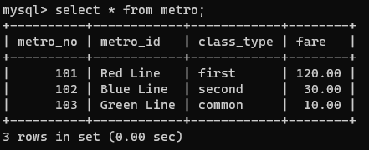
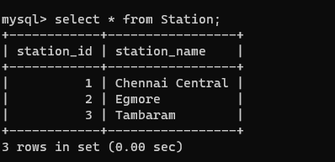
SQL CODE
CREATE TABLE metro ( metro_no INT PRIMARY KEY, metro_name VARCHAR(255) NOT NULL, class_type VARCHAR(255) NOT NULL, fare DECIMAL(10,2) NOT NULL);
CREATE TABLE Station ( station_id INT PRIMARY KEY, station_name VARCHAR(255) NOT NULL);

Slide 8
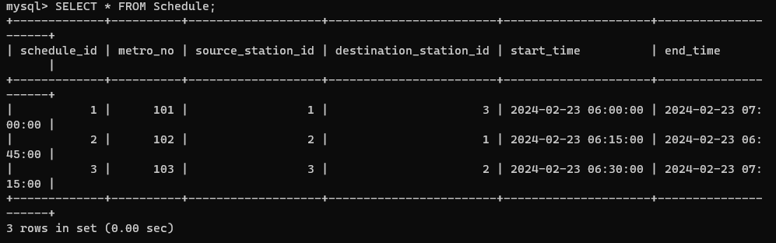
SQL table
CREATE TABLE Schedule ( schedule_id INT PRIMARY KEY, metro_no INT NOT NULL, source_station_id INT NOT NULL, destination_station_id INT NOT NULL, start_time DATETIME NOT NULL, end_time DATETIME NOT NULL, FOREIGN KEY (metro_no) REFERENCES metro(metro_no), FOREIGN KEY (source_station_id) REFERENCES Station(station_id), FOREIGN KEY (destination_station_id) REFERENCES Station(station_id));

Slide 9
SQL CODE
CREATE TABLE Route ( route_id INT PRIMARY KEY, schedule_id INT NOT NULL, station_id INT NOT NULL, stop_no INT NOT NULL, FOREIGN KEY (schedule_id) REFERENCES Schedule(schedule_id), FOREIGN KEY (station_id) REFERENCES Station(station_id));
CREATE TABLE Waitlist ( waitlist_id INT PRIMARY KEY, passenger_id INT NOT NULL, schedule_id INT NOT NULL, date_time DATETIME NOT NULL, priority INT NOT NULL, FOREIGN KEY (passenger_id) REFERENCES Passenger(passenger_id), FOREIGN KEY (schedule_id) REFERENCES Schedule(schedule_id));

Slide 10
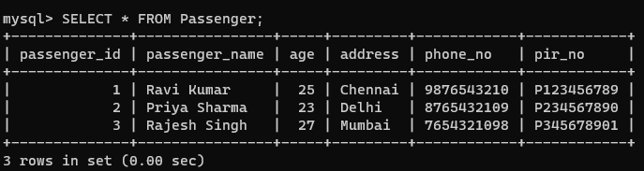
SQL CODE
CREATE TABLE Passenger ( passenger_id INT PRIMARY KEY, passenger_name VARCHAR(255) NOT NULL, age INT NOT NULL, address VARCHAR(255) NOT NULL, phone_no VARCHAR(255) NOT NULL, pir_no VARCHAR(255) NOT NULL);

Slide 11
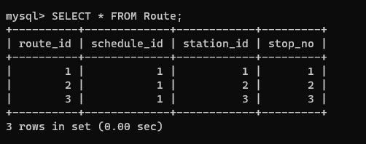
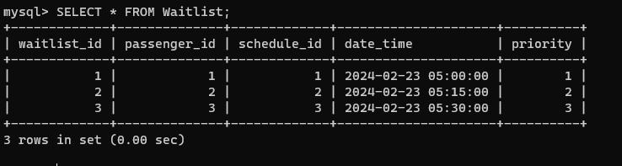
SQL Tables

Slide 12
THANK YOU

